Slide 1
DevOps
Training

Slide 2
Agenda
https://docs.google.com/document/d/1FqtiHpTmStWRWv1H0sx_SLb_CYQNVNYu/edit

Slide 3
Training Format
Concepts
Hands-on exercises
Assignments
Interactive

Slide 4
Timing
Start time at 9.30 am
Break 11.15
Lunch 1pm to 2pm
Break 3.45
End at 5.30 pm

Slide 5
Infra setup
AWS Account
VS Code
Git
Docker
Kubernetes
Terraform
Ansible
Jenkins

Slide 6
DevOps
DevOps is a set of practices that combines software development (Dev) and IT operations (Ops). Its goal is to shorten the development lifecycle, deliver high-quality software continuously, and improve collaboration between development and operations teams.
Collaboration and Communication: DevOps fosters a culture of collaboration between development and operations teams, breaking down silos and encouraging joint ownership of the software development lifecycle.
Continuous Integration (CI): Developers frequently integrate their code changes into a shared repository. Automated build and test processes verify each integration, helping to catch bugs early.

Slide 7
DevOps
Continuous Delivery (CD): Extends CI by automatically deploying code changes to a production-like environment after passing tests. This ensures that software can be released reliably at any time.
Infrastructure as Code (IaC): Managing and provisioning computing infrastructure through machine-readable definition files, rather than physical hardware configuration or interactive configuration tools. Tools like Terraform and AWS CloudFormation are often used.
Version Control: Using tools like Git to manage code changes and track the history of software development, enabling multiple developers to collaborate on the same project.

Slide 8
DevOps
Monitoring and Logging: Continuous monitoring and logging of applications and infrastructure to gather insights and improve performance. Tools like Prometheus, Grafana, ELK Stack, and AWS CloudWatch are common in this area.
Automation: Automating repetitive tasks such as code testing, integration, deployment, and infrastructure provisioning to increase efficiency and reduce the potential for human error.
Security (DevSecOps): Integrating security practices within the DevOps process to ensure that security is considered at every stage of the software development lifecycle.

Slide 9
DevOps
Containerization and Orchestration: Using containers (e.g., Docker) to package applications and their dependencies, and orchestrating them (e.g., Kubernetes) for efficient deployment and scaling.
Continuous Feedback: Gathering feedback from end-users and monitoring systems to inform future development and operations activities, creating a cycle of continuous improvement.
By implementing DevOps practices, organizations can achieve faster delivery of features, improved operational efficiency, higher quality products, and increased collaboration among teams.

Slide 10
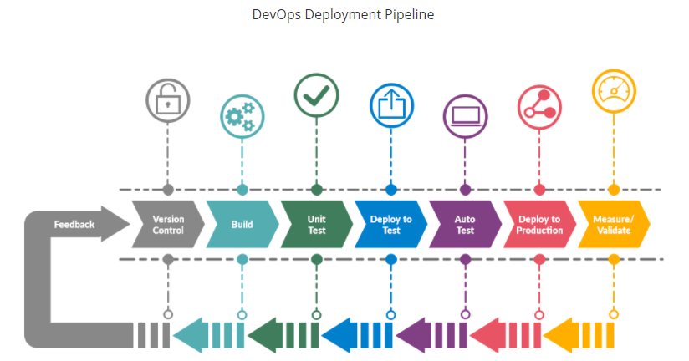

Slide 11
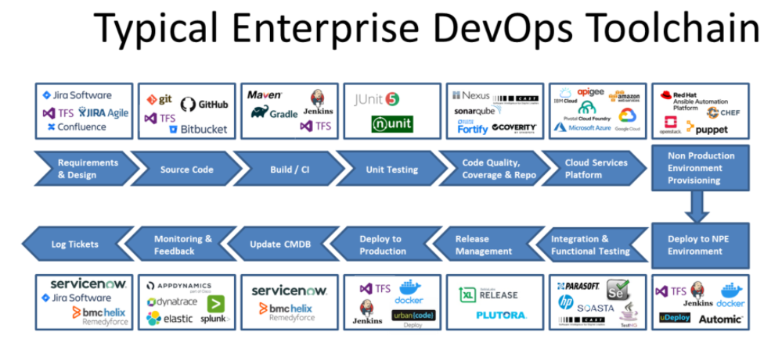

Slide 12
Git
Git is a distributed version control system used to track changes in source code during software development.
Install Git
First, you need to install Git on your computer. You can download it from git-scm.com.
Configure Git
After installing Git, you need to set up your user name and email address. Open your terminal or command prompt and type:
git config --global user.name "Your Name"
git config --global user.email "your.email@example.com"

Slide 13
Git
Basic Git Commands
Initialize a Repository
To start tracking a project with Git, navigate to your project directory and initialize a Git repository:
cd your-project-directory
git init
Check the Status
To see the status of your files (e.g., changes that need to be committed), use:
git status

Slide 14
Git
Add Files
To stage files for commit, use:
git add filename
To add all changes, use:
git add .
Commit Changes
To commit the staged files with a message, use:
git commit -m "Your commit message"

Slide 15
Git
Viewing the Commit History
To see the commit history, use:
git log
Create a Branch
To create a new branch and switch to it, use:
git branch new-branch-name
git checkout new-branch-name
git checkout -b new-branch-name

Slide 16
Git
Merge Branches
To merge a branch into your current branch, use:
git checkout main
git merge new-branch-name
Delete a Branch
To delete a branch that you no longer need, use:
git branch -d branch-name

Slide 17
Git
Pushing Changes
To push your changes to a remote repository, use:
git remote add origin https://github.com/your-username/your-repository.git
git push -u origin main
After the first time, you can simply use:
git push
Pulling Changes
To pull changes from a remote repository, use:
git pull

Slide 18
Git
Common Git Workflows
Cloning a Repository
To clone an existing repository from GitHub, use:
git clone https://github.com/username/repository.git
Working with Remotes
To list your remotes, use:
git remote -v
To add a new remote, use:
git remote add remote-name https://github.com/user/repo.git

Slide 19
Git
Stashing Changes
To stash your changes without committing them, use:
git stash
To apply stashed changes, use:
git stash apply

Slide 20
Git
git checkout feature-branch
git log --oneline
git checkout main
git cherry-pick <ABOVE COMMIT ID>
git push origin main

Slide 21
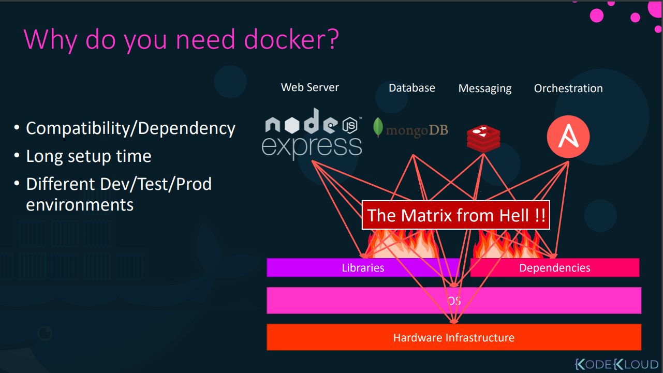

Slide 22
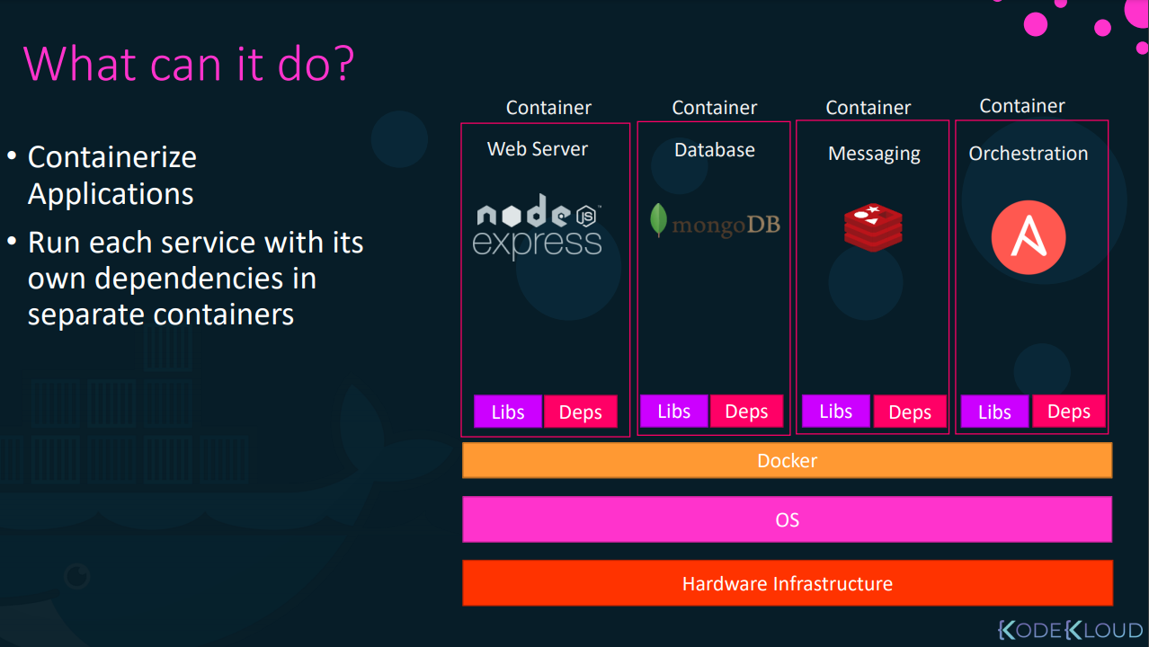

Slide 23
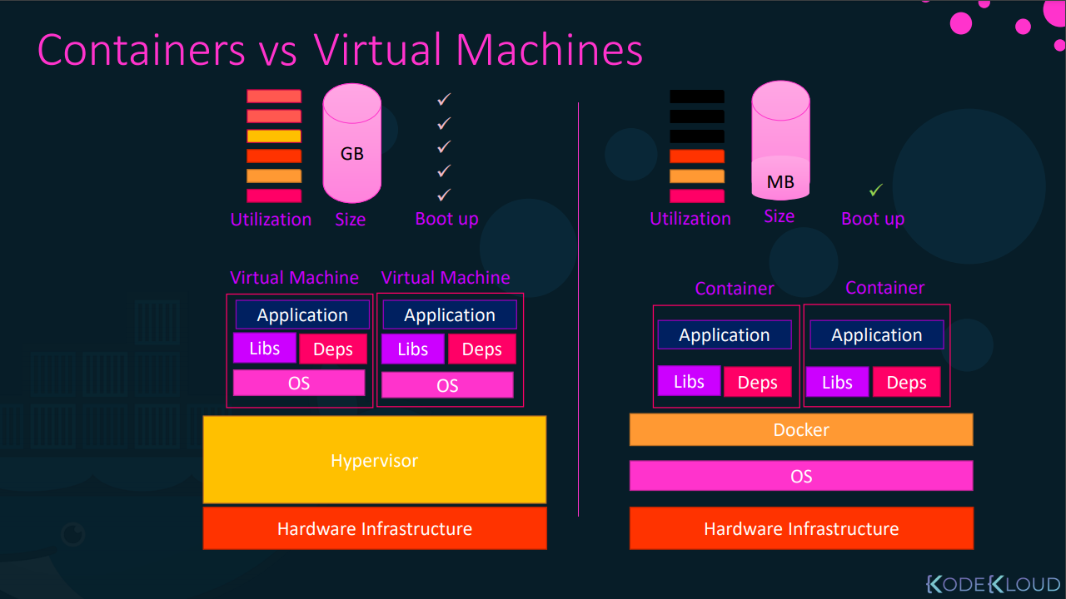

Slide 24
Docker
Docker is an open platform for developing, shipping, and running applications.
Docker enables you to separate your applications from your infrastructure so you can deliver software quickly.
With Docker, you can manage your infrastructure in the same ways you manage your applications.
By taking advantage of Docker’s methodologies for shipping, testing, and deploying code quickly, you can significantly reduce the delay between writing code and running it in production.

Slide 25
Docker
Docker provides the ability to package and run an application in a loosely isolated environment called a container.
The isolation and security allows you to run many containers simultaneously on a given host.
Containers are lightweight and contain everything needed to run the application, so you do not need to rely on what is currently installed on the host.
You can easily share containers while you work, and be sure that everyone you share with gets the same container that works in the same way.

Slide 26
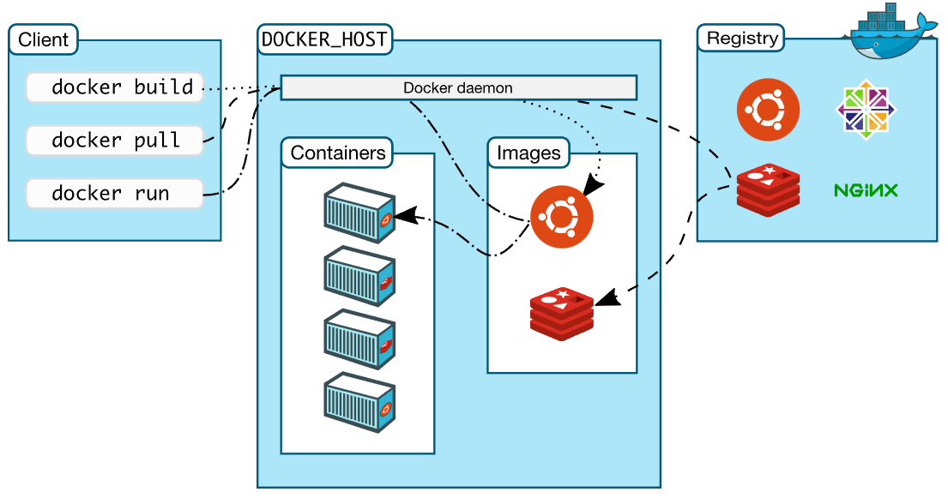
Docker architecture

Slide 27
Installation
Provision VM - EC2 instance AWS Cloud
Install Docker - https://github.com/arjunachari12/install-jenkins-container/blob/main/install-docker.md
Install VS Code in local laptop
Install “Remote - SSH” extensions
Install “Docker” plugin in extensions

Slide 28
Docker commands
docker version
docker info
docker
docker container run
docker run
docker search ubuntu
docker pull ubuntu
docker run ubuntu

Slide 29
Docker commands
docker container run --publish 80:80 nginx
docker container run --publish 80:80 --detach nginx
docker container ls
docker container stop
docker container ls
docker container ls -a
docker container run --publish 80:80 --detach --name webhost nginx
docker container run -d -p 3306:3306 --name db -e MYSQL_RANDOM_ROOT_PASSWORD=yes mysql

Slide 30
Solution
Search : docker search mongo
Pull : docker pull mongo
Run : docker run mongo
List images : docker image ls
List container : docker container ls
Stop : docker container stop CONTAINER-ID
Start : docker container start CONTAINER-ID
Delete container : docker container rm CONTAINER-ID -f
Delete image : docker image rm mongo

Slide 31
Assignment
Challenge: Run mysql image and give a user friendly name as db
Approach to solve this problem:
Go to hub.docker.com and search for MySQL, read the document, follow the instruction

Slide 32
Assignment
docker container run -d --name db -e MYSQL_RANDOM_ROOT_PASSWORD=true mysql

Slide 33
Commands - Tags
docker container run -d --name db -e MYSQL_RANDOM_ROOT_PASSWORD=true mysql:8.0
docker image history nginx

Slide 34
Docker commands: Get into the new container
docker container run -it --name webserver nginx bash
#after ssh, create a simple folder
mkdir arjun
exit

Slide 35
Assignment: Get into the existing container
SSH into running container
SOLUTION
docker container ls -a
docker container start CONTAINER-ID
docker container exec -it webserver bash

Slide 36
Assignment
Create your own image from Ubuntu
Pull Ubuntu
Get inside the container
Install python 3.5
Install node 12 or node 8
Save the container with this new change
Create new custom image
docker commit

Slide 37
Solution
docker container run -it ubuntu bash
apt update
apt install python3
python3 -V
apt install nodejs
nodejs -v
exit
docker commit d6da908416ed custom-image
docker image ls

Slide 38
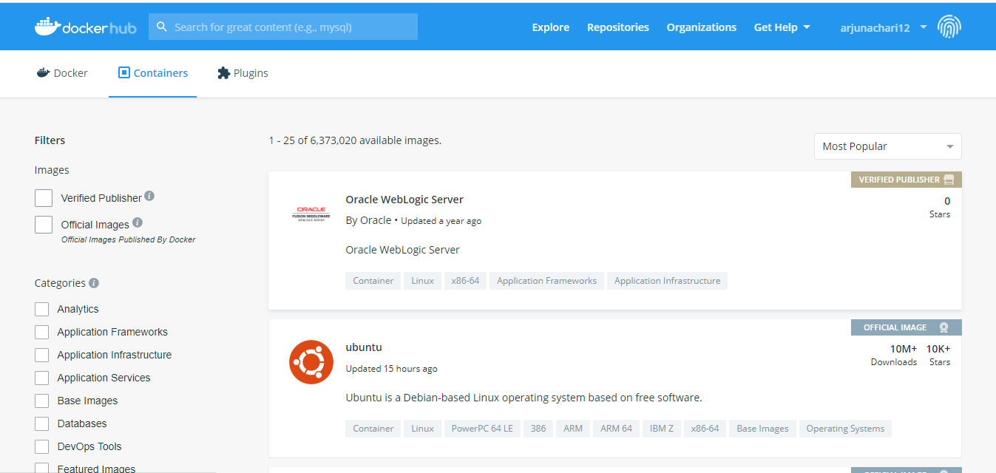
Docker hub

Slide 39
Push Docker custom image to Docker Hub
Pre-requisites
Create an account with Docker Hub
Create a repository in Docker hub under your account:
Click of Create Repository
Give a name as “custom-image”
Select Public repo as Visibility
Click on Create
Copy the repo name ex: arjunachari12/custom-image
docker login
#enter username and password of docker hub
docker tag custom-image arjunachari12/custom-image
docker push arjunachari12/custom-image
#refresh docker hub and you must see new image uploaded

Slide 40
Assignment
Install git into custom-container
Upload the new image with a tag 1.0

Slide 41
What’s going on in containers
docker container top - process list
docker container inspect - details of container config
docker container stats - performance stats
docker container logs - get logs

Slide 42
commands
docker container run --publish 80:80 --detach --name webhost nginx
docker container logs webhost
docker container top webhost
docker container run -d --name mysql -e MYSQL_RANDOM_ROOT_PASSWORD=true mysql
docker container inspect mysql
docker container stats mysql

Slide 43
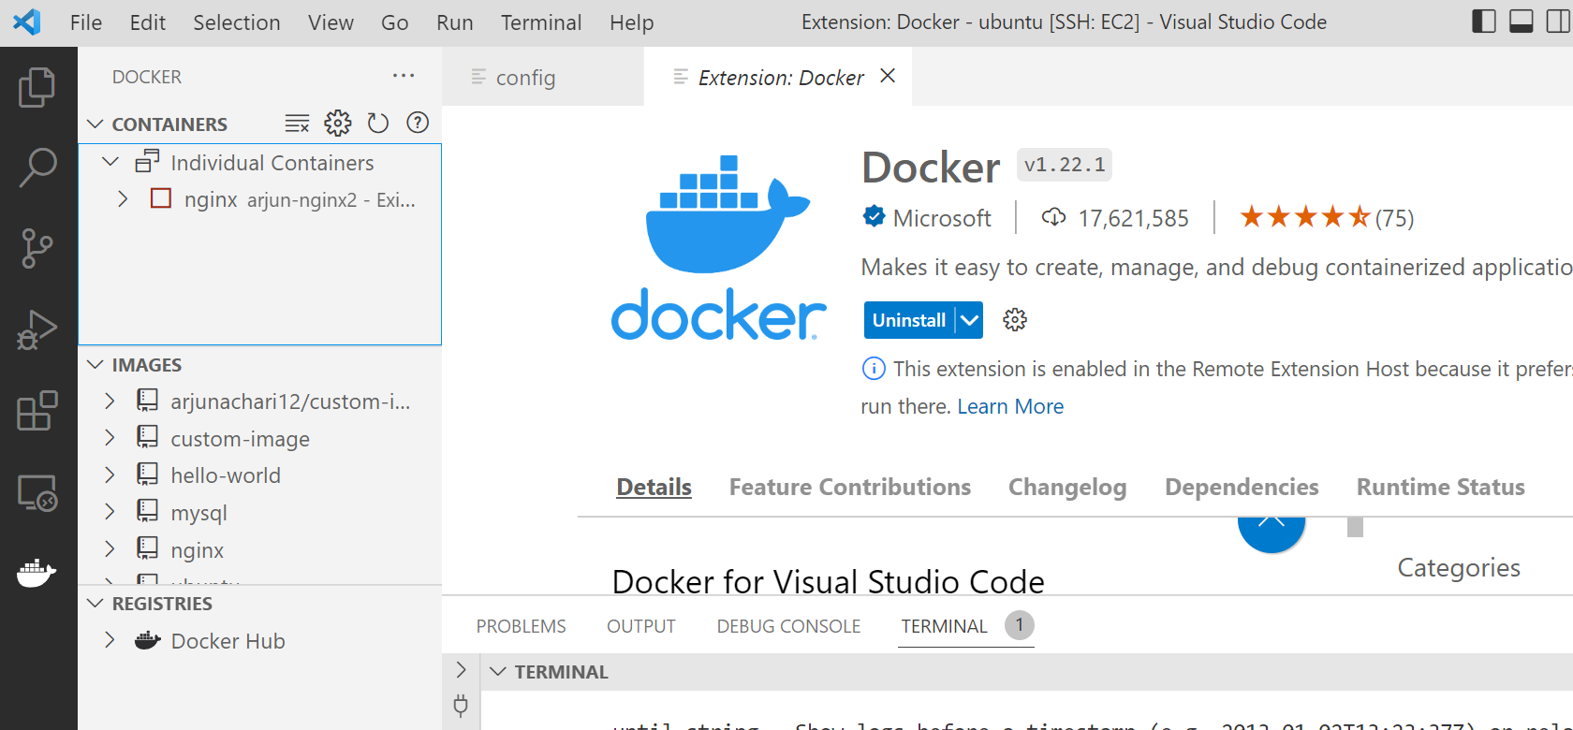
Work VS code Docker extension

Slide 44
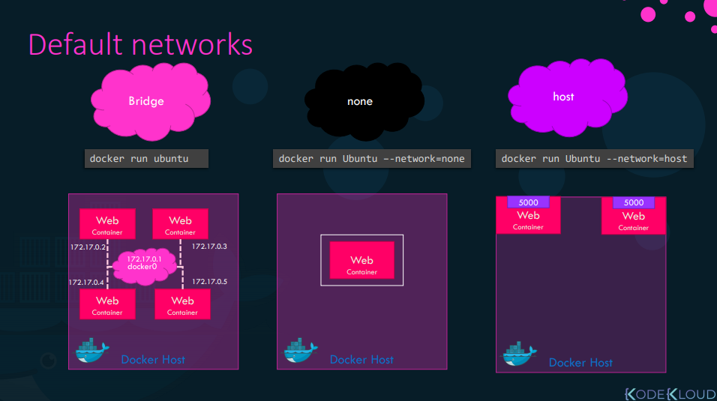
https://docs.docker.com/network/

Slide 45
Network commands
docker network ls
docker network inspect bridge
docker network ls
docker network create my_app_net
docker network ls
docker network create --help
docker container run -d --name new_nginx --network my_app_net nginx
docker network inspect my_app_net

Slide 46
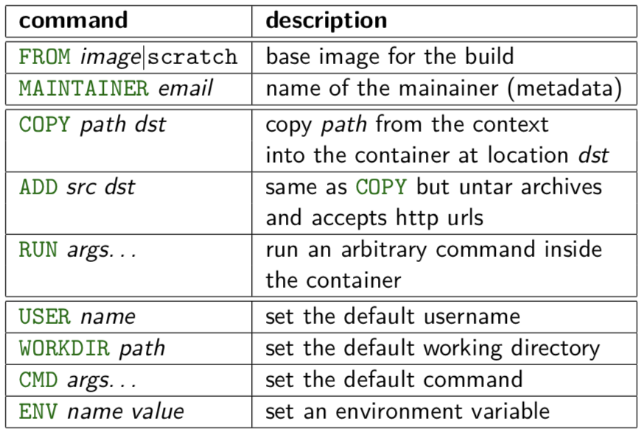
Dockerfile
https://docs.docker.com/engine/reference/builder/

Slide 47
Dockerfile
https://github.com/arjunachari12/docker-demo-with-simple-python-app
git clone https://github.com/arjunachari12/docker-demo-with-simple-python-app.git
Docker file
FROM python:2.7
RUN mkdir -p /usr/src/app
WORKDIR /usr/src/app
COPY requirements.txt /usr/src/app/
RUN pip install --no-cache-dir -r requirements.txt
COPY . /usr/src/app
ENV PORT 8080
EXPOSE $PORT
VOLUME ["/app-data"]
CMD gunicorn -b :$PORT -c gunicorn.conf.py main:app

Slide 48
Dockerfile
docker build -t my-python-app:1.0.0 .
#Create docker registry in docker hub called as my-python-app, copy the registry name
docker tag my-python-app:1.0.0 arjunachari12/my-python-app:1.0.0
docker login
Docker push arjunachari12/my-python-app:1.0.0

Slide 49
Volumes
By default all files created inside a container are stored on a writable container layer. This means that:
The data doesn’t persist when that container no longer exists, and it can be difficult to get the data out of the container if another process needs it.
A container’s writable layer is tightly coupled to the host machine where the container is running. You can’t easily move the data somewhere else.
Writing into a container’s writable layer requires a storage driver to manage the filesystem. The storage driver provides a union filesystem, using the Linux kernel. This extra abstraction reduces performance as compared to using data volumes, which write directly to the host filesystem.

Slide 50
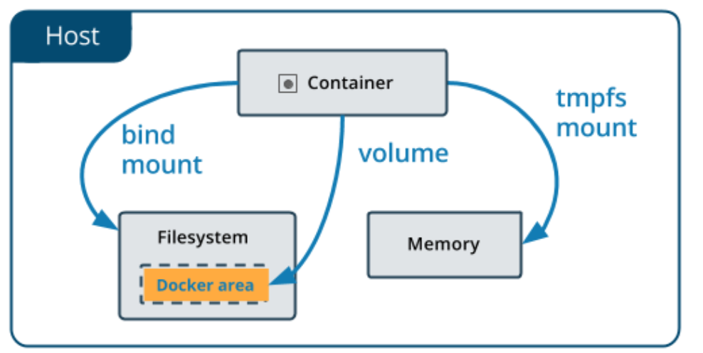
Volumes
Volumes are stored in a part of the host filesystem which is managed by Docker (/var/lib/docker/volumes/ on Linux). Volumes are the best way to persist data in Docker.
Bind mounts may be stored anywhere on the host system. They may even be important system files or directories. Non-Docker processes on the Docker host or a Docker container can modify them at any time.
tmpfs mounts are stored in the host system’s memory only, and are never written to the host system’s filesystem.

Slide 51
Volumes
Volumes are the preferred mechanism for persisting data generated by and used by Docker containers. While bind mounts are dependent on the directory structure and OS of the host machine, volumes are completely managed by Docker. Volumes have several advantages over bind mounts:
Volumes are easier to back up or migrate than bind mounts.
You can manage volumes using Docker CLI commands or the Docker API.
Volumes work on both Linux and Windows containers.
Volumes can be more safely shared among multiple containers.
Volume drivers let you store volumes on remote hosts or cloud providers, to encrypt the contents of volumes, or to add other functionality.
New volumes can have their content pre-populated by a container.
Volumes on Docker Desktop have much higher performance than bind mounts from Mac and Windows hosts.

Slide 52
Docker volume
docker container run -d --name mysql -e MYSQL_ALLOW_EMPTY_PASSWORD=True mysql
docker container inspect mysql
docker volume ls
docker volume inspect TAB COMPLETION
docker volume create mysql-db
docker container run -d --name mysql -e MYSQL_ALLOW_EMPTY_PASSWORD=True -v mysql-db:/var/lib/mysql mysql

Slide 53
Docker volume - Bind Mount
mkdir html
#add index.html page under html folder
#add some text as “Welcome to Bind mount”
cd html
docker container run -d --name nginx -p 80:80 -v $(pwd):/usr/share/nginx/html nginx

Slide 54
Assignment
Do below steps
Dockerize below sample application
push it to Docker Hub
Delete image locally
Pull from your docker hub and run it
Nodejs: https://docs.docker.com/language/nodejs/build-images/
Java: https://docs.docker.com/language/java/build-images/
Go lang: https://docs.docker.com/language/golang/build-images/

Slide 55
Network commands
docker network --help
docker network connect
docker container inspect TAB COMPLETION
docker container disconnect TAB COMPLETION
docker container inspect
## Docker Networks: DNS and How Containers Find Each Other
docker container ls
docker network inspect TAB COMPLETION
docker container run -d --name my_nginx --network my_app_net nginx
docker network create --driver=bridge --subnet=10.0.0.0/16 --ip-range=10.0.0.0/24 --gateway=10.0.0.1 eth2

Slide 56
commands
docker container run --publish 80:80 --detach --name webhost nginx
docker container logs webhost
docker container top webhost
docker container run -d --name mysql -e MYSQL_RANDOM_ROOT_PASSWORD=true mysql
docker container inspect mysql
docker container stats mysql

Slide 57
Assignment
Assignment 1: Perform below for mongo image:
Search docker search mongo
Pull docker pull mongo
Run docker run mongo
List images docker image ls
List container docker container ls
Stop docker container stop CONTAINER-ID
Start docker container staty CONTAINER-ID
Delete docker container rm CONTAINER-ID -f
Delete image docker image rm mongo

Slide 58
Kubernetes
Kubernetes is like linux kernel of distributed systems.
It abstracts away the underlying hardware of the nodes and provides a uniform interface for applications to be both deployed and consume the shared pool of resources.

Slide 59
Architecture Overview
Masters - Acts as the primary control plane for Kubernetes. Masters are responsible at a minimum for running the API Server, scheduler, and cluster controller. They commonly also manage storing cluster state, cloud-provider specific components and other cluster essential services.
Nodes - Are the ‘workers’ of a Kubernetes cluster. They run a minimal agent that manages the node itself, and are tasked with executing workloads as designated by the master.

Slide 60
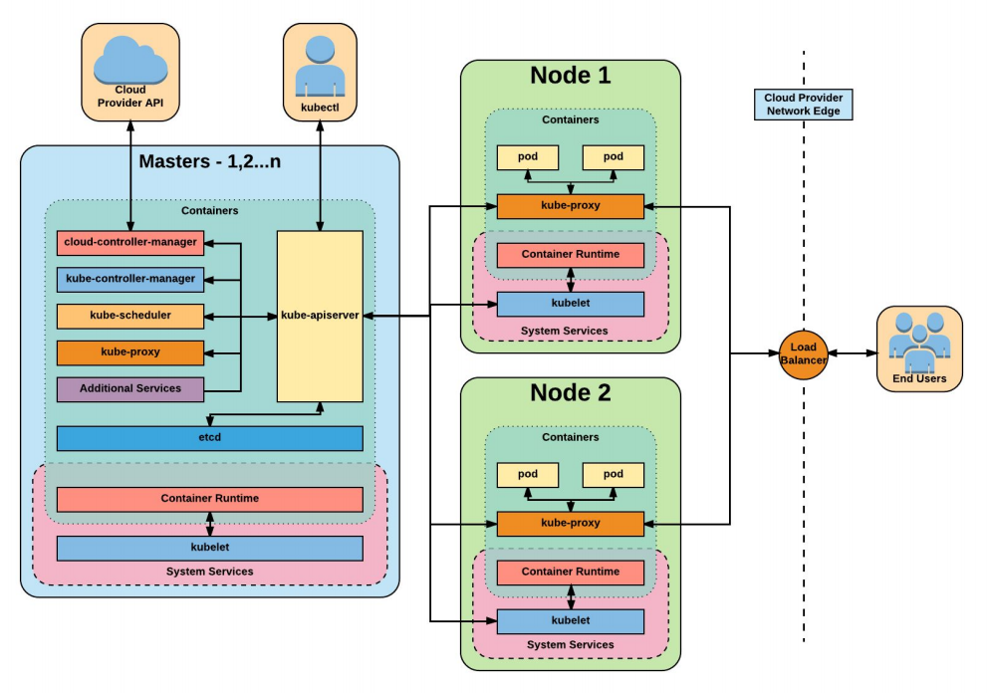

Slide 61
Installation
Install Minikube and Kubectl
https://github.com/arjunachari12/install-jenkins-container/blob/main/kubernetes.md

Slide 62
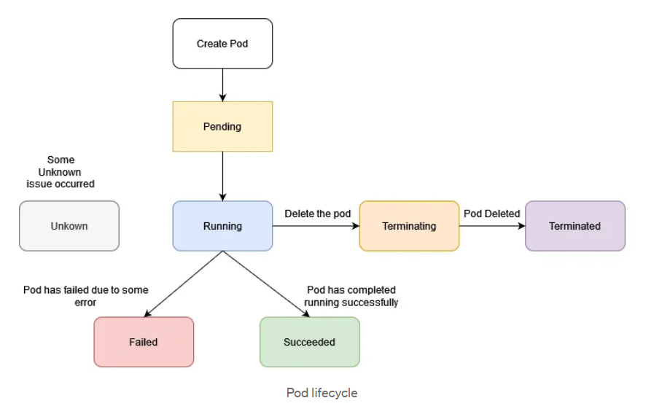
Pods lifecycle

Slide 63
Exercise: Run image as pod
Hands-on steps:
Step 1: Open VS code and create new folder
Step 2 : write manifest file pod.yml, copy code from below link
https://github.com/arjunachari12/k8s-learn/blob/main/pod.yml
Step 3: Execute pod.yml file using below command
kubectl create -f pod.yml
Step 4: You should see pod created message
Step 5: run below commands
kubectl get pod
kubeclt describe pod pod
kubectl delete pod

Slide 64
Assignment: Run multiple images as pod
Hands-on steps:
Step 1: Open VS code and create new folder
Step 2 : write manifest file pod.yml, copy code from below link
https://github.com/arjunachari12/k8s-learn/blob/main/pod2.yml
Step 3: Execute pod.yml file using below command
kubectl create -f pod2.yml
Step 4: You should see pod created message
Step 5: run below commands
kubectl get pod
kubeclt describe pod pod1
kubectl delete pod pod1

Slide 65
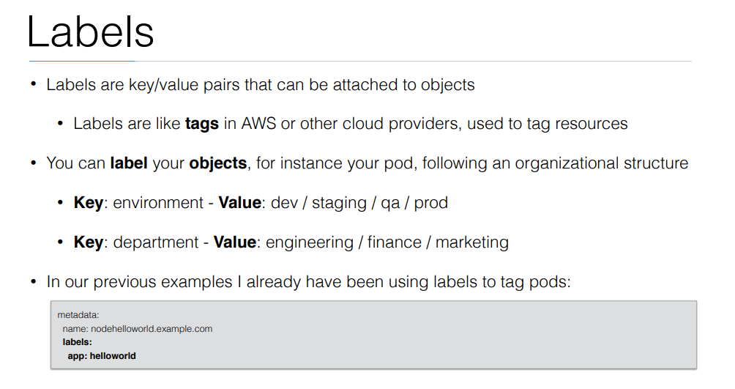

Slide 66
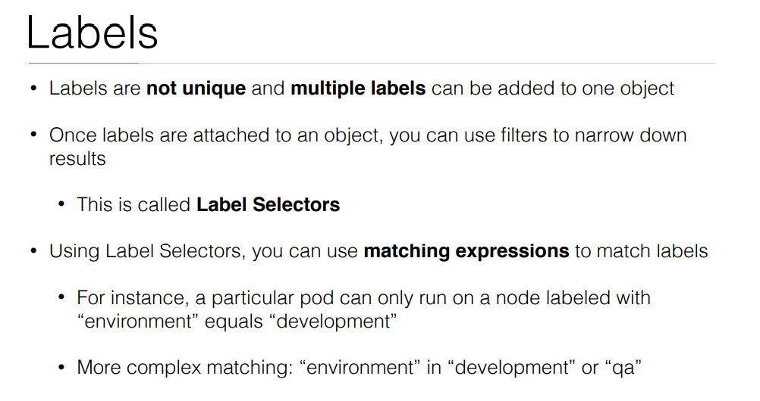

Slide 67
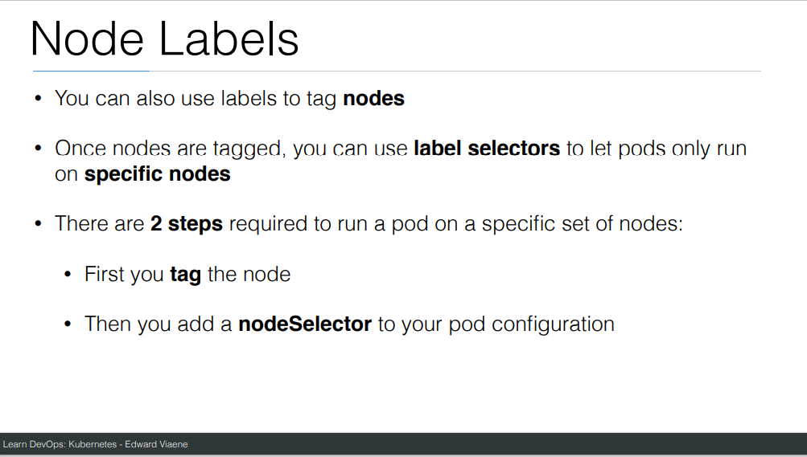

Slide 68
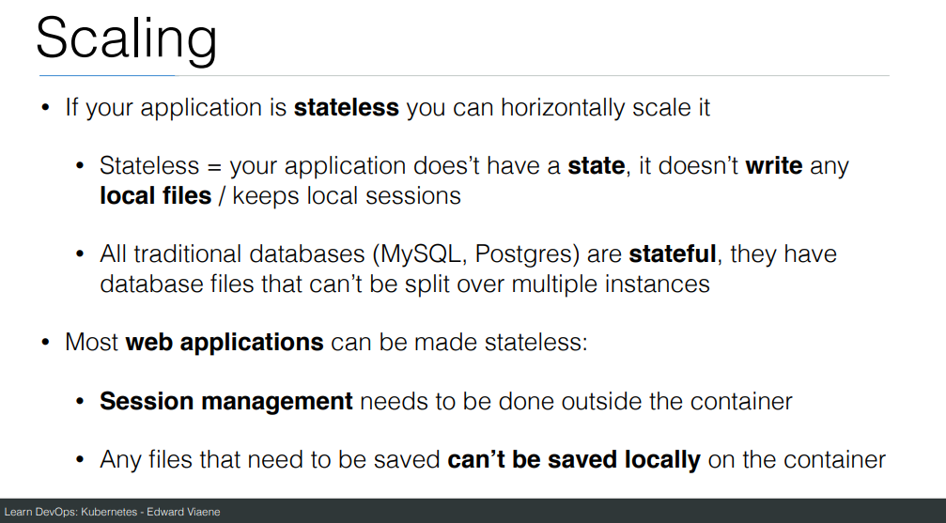

Slide 69
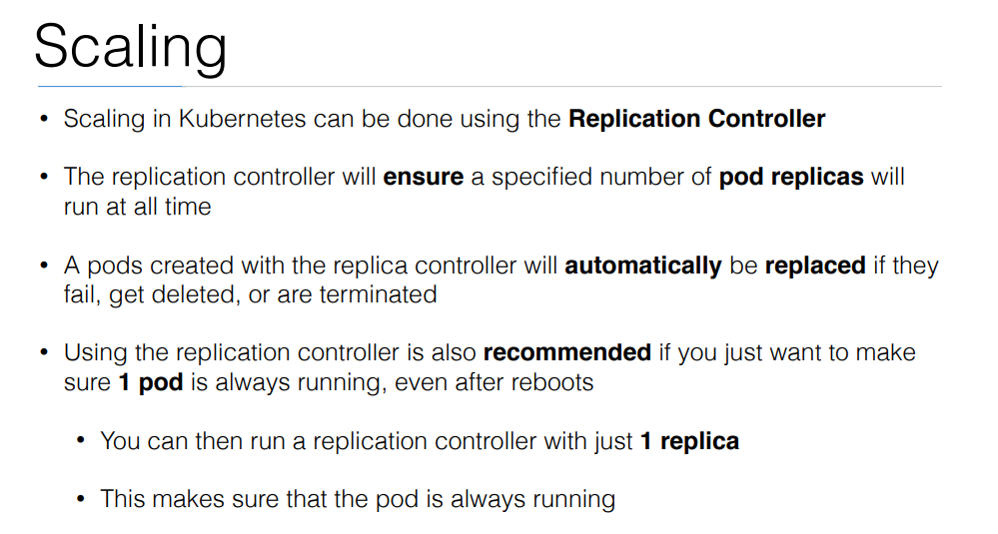

Slide 70
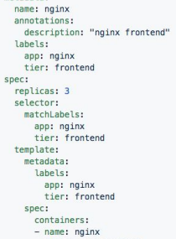
ReplicaSet
Generated ReplicaSet from Deployment spec.

Slide 71
Replicaset
kubectl create -f helloworld_replicaset.yaml
kubectl get rs
kubectl autoscale rs helloworld-controller --max=5
kubectl delete rs helloworld-controller
kubectl edit pods helloworld-controller-9jlsq

Slide 72
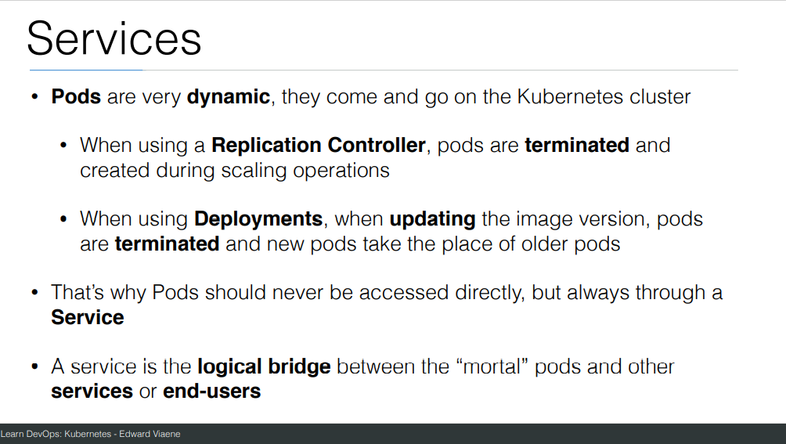

Slide 73
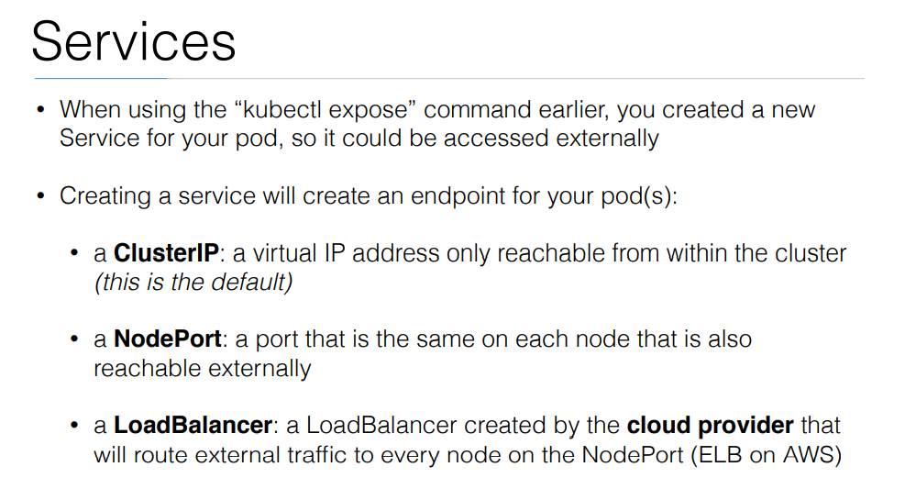

Slide 74
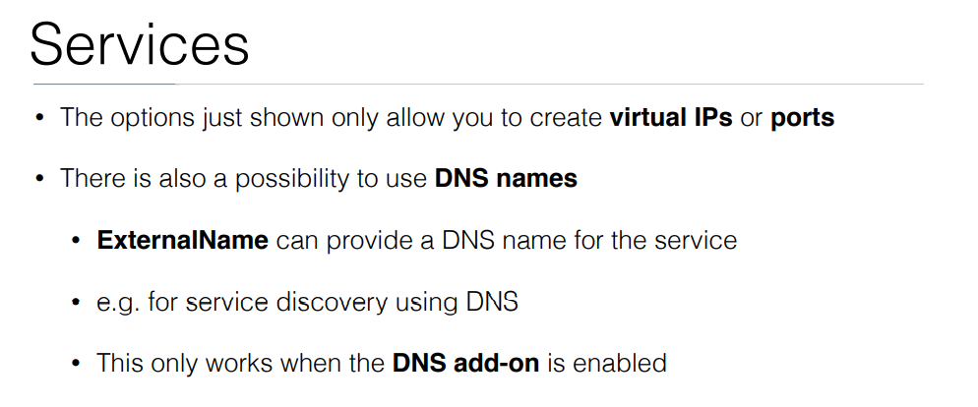

Slide 75
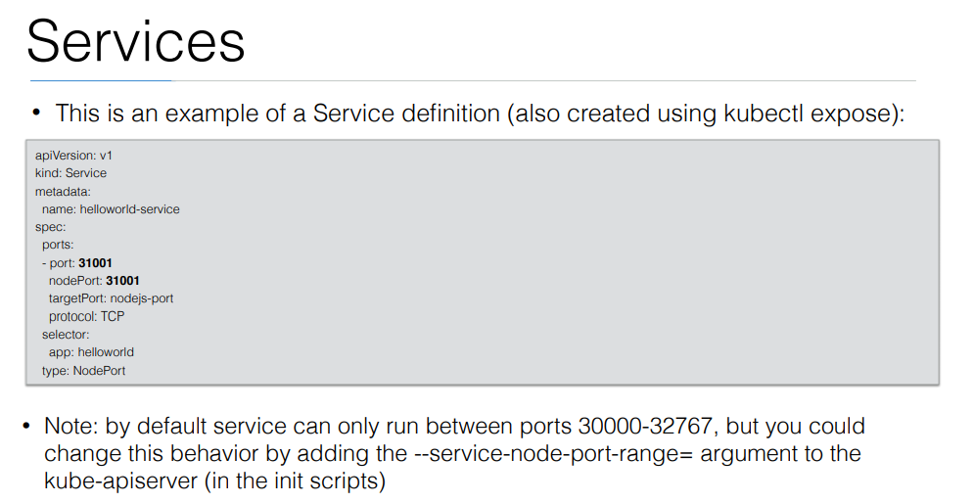

Slide 76
Exercise: Run image as pod
Hands-on steps:
Step 1: Open VS code and create new folder
Step 2 : write manifest file pod3.yml, copy code from below link
https://github.com/arjunachari12/k8s-learn/blob/main/pod3.yml
Step 3: Execute pod.yml file using below command
kubectl create -f pod3.yml
Step 4: You should see pod created message
Step 5: run below commands
kubectl get pod
kubeclt describe pod pod3

Slide 77
Exercise: Expose pod as Service
Hands-on steps:
Step 1: Open VS code and create new folder
Step 2 : write manifest file pod3-service.yml, copy code from below link
https://github.com/arjunachari12/k8s-learn/blob/main/pod3-service.yml
Step 3: Execute pod3-service.yml file using below command
kubectl create -f pod3-service.yml
Step 4: You should see pod created message

Slide 78
Exercise: Expose pod as Service
Hands-on steps:
Step 5: run below commands
kubectl get pod
kubeclt describe pod pod3
kubectl get svc
minikube service helloworld-service --url
kubectl describe svc helloworld-service
kubectl describe svc
Kubectl get svc
kubectl delete svc helloworld-nodeport-service.yml

Slide 79
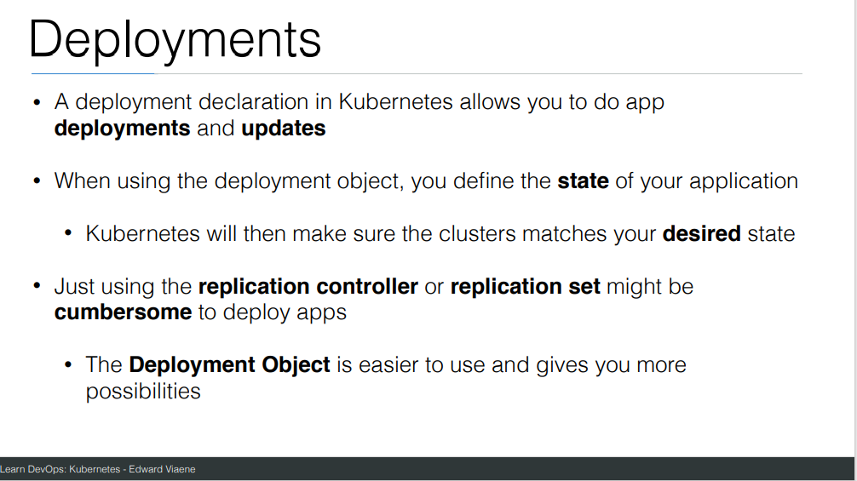

Slide 80
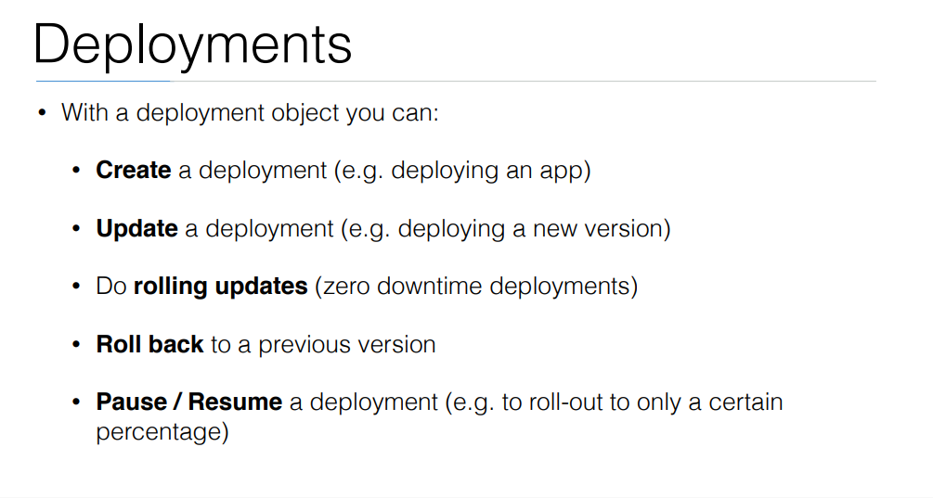

Slide 81
commands
Create a file called helloworld-deployment.yaml
Copy content from https://github.com/arjunachari12/k8s-learn/blob/main/helloworld-deployment.yml
kubectl create -f helloworld-deployment.yaml
kubectl get deployments
kubectl get rs
kubectl get pods
kubectl get pods --show-labels
kubectl rollout status deployment/helloworld-deployment

Slide 82
commands
Created new version of docker image and uploaded in docker hub
kubectl expose deployment helloworld-deployment --type=NodePort
kubectl get svc
minikube service helloworld-deployment --url
Curl url
kubectl set image deployment/helloworld-deployment k8s-demo=arjunachari12/k8s-demo:2
see
Curl to see new version

Slide 83
commands
kubectl get pods
kubectl rollout history deployment/helloworld-deployment
kubectl get pods
kubectl rollout undo deployment/helloworld-deployment
Curl again #modify history count
kubectl edit deployment/helloworld-deployment

Slide 84
What is Jenkins?
Jenkins is a self-contained, open source automation server which can be used to automate all sorts of tasks related to building, testing, and delivering or deploying software.
Jenkins can be installed through native system packages, Docker, or even run standalone by any machine w bith a Java Runtime Environment (JRE) installed

Slide 85
Install Jenkins
Install Docker
https://github.com/arjunachari12/install-jenkins-container/blob/main/install-docker.md
Install Jenkins
https://github.com/arjunachari12/install-jenkins-container/blob/main/jenkins.md
Official link
https://www.jenkins.io/doc/book/installing/docker/

Slide 86
Pipeline
Jenkins Pipeline (or simply "Pipeline" with a capital "P") is a suite of plugins which supports implementing and integrating continuous delivery pipelines into Jenkins.
Pipeline provides an extensible set of tools for modeling simple-to-complex delivery pipelines "as code" via the Pipeline domain-specific language (DSL) syntax.
The definition of a Jenkins Pipeline is written into a text file (called a Jenkinsfile) which in turn can be committed to a project’s source control repository.
This is the foundation of "Pipeline-as-code"; treating the CD pipeline a part of the application to be versioned and reviewed like any other code.

Slide 87
Pipeline
Creating a Jenkinsfile and committing it to source control provides a number of immediate benefits:
Automatically creates a Pipeline build process for all branches and pull requests.
Code review/iteration on the Pipeline (along with the remaining source code).
Audit trail for the Pipeline.
Single source of truth for the Pipeline, which can be viewed and edited by multiple members of the project.
While the syntax for defining a Pipeline, either in the web UI or with a Jenkinsfile is the same, it is generally considered best practice to define the Pipeline in a Jenkinsfile and check that in to source control

Slide 88
Why Pipeline?
Jenkins is, fundamentally, an automation engine which supports a number of automation patterns.
Pipeline adds a powerful set of automation tools onto Jenkins, supporting use cases that span from simple continuous integration to comprehensive CD pipelines. By modeling a series of related tasks, users can take advantage of the many features of Pipeline:
Code: Pipelines are implemented in code and typically checked into source control, giving teams the ability to edit, review, and iterate upon their delivery pipeline.
Durable: Pipelines can survive both planned and unplanned restarts of the Jenkins controller.

Slide 89
Why Pipeline?
Pausable: Pipelines can optionally stop and wait for human input or approval before continuing the Pipeline run.
Versatile: Pipelines support complex real-world CD requirements, including the ability to fork/join, loop, and perform work in parallel.
Extensible: The Pipeline plugin supports custom extensions to its DSL footnote:dsl:[] and multiple options for integration with other plugins.
While Jenkins has always allowed rudimentary forms of chaining Freestyle Jobs together to perform sequential tasks, Pipeline makes this concept a first-class citizen in Jenkins.

Slide 90
Pipeline concepts
The following concepts are key aspects of Jenkins Pipeline, which tie in closely to Pipeline syntax
Pipeline:
A Pipeline is a user-defined model of a CD pipeline. A Pipeline’s code defines your entire build process, which typically includes stages for building an application, testing it and then delivering it.
Node:
A node is a machine which is part of the Jenkins environment and is capable of executing a Pipeline.

Slide 91
Pipeline concepts
Stage
A stage block defines a conceptually distinct subset of tasks performed through the entire Pipeline (e.g. "Build", "Test" and "Deploy" stages), which is used by many plugins to visualize or present Jenkins Pipeline status/progress.
Step
A single task. Fundamentally, a step tells Jenkins what to do at a particular point in time (or "step" in the process). For example, to execute the shell command make use the sh step: sh 'make'. When a plugin extends the Pipeline DSL, [1] that typically means the plugin has implemented a new step.

Slide 92
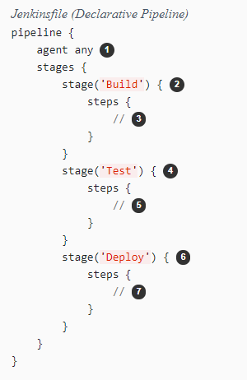
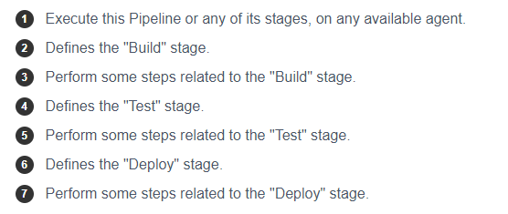
Declarative Pipeline

Slide 93
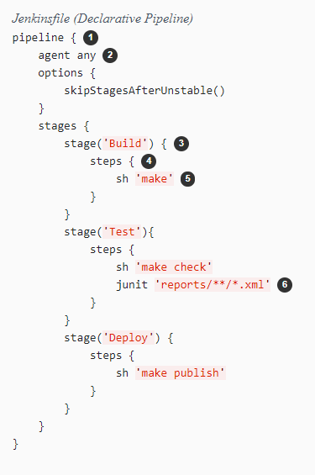
Pipeline example

Slide 94
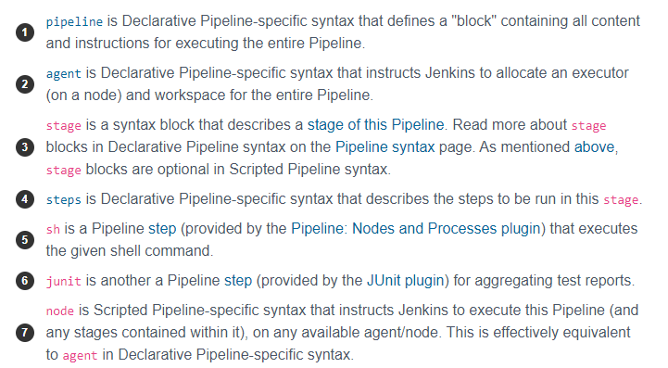
Pipeline example

Slide 95
Defining a Pipeline
Both Declarative and Scripted Pipeline are DSLs [1] to describe portions of your software delivery pipeline. Scripted Pipeline is written in a limited form of Groovy syntax.
A Pipeline can be created in one of the following ways:
Through Blue Ocean - after setting up a Pipeline project in Blue Ocean, the Blue Ocean UI helps you write your Pipeline’s Jenkinsfile and commit it to source control.
Through the classic UI - you can enter a basic Pipeline directly in Jenkins through the classic UI.
In SCM - you can write a Jenkinsfile manually, which you can commit to your project’s source control repository.

Slide 96
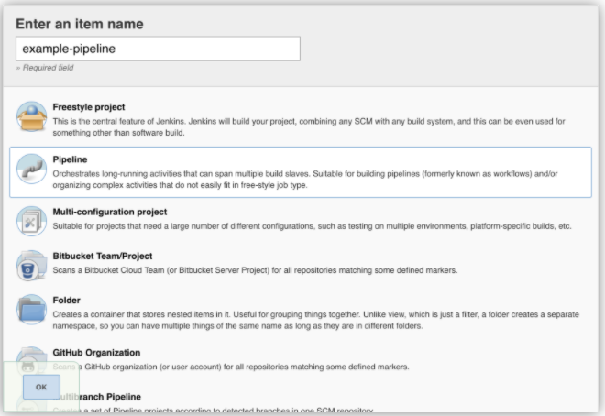
Through the classic UI

Slide 97
Exercise 1 - Create a pipeline as code to print hello world
Steps:
Create a new pipline, give a name as pipeline1
Under pipeline section Pipeline script option
Paste below code
pipeline {
agent any
stages {
stage('Stage 1') {
steps {
echo 'Welcome to jenkins!'
}
}
}
}

Slide 98
Exercise 2 - stages
stage('Test') {
steps {
echo 'Testing..'
}
}
pipeline {
agent any
stages {
stage('Build') {
steps {
echo 'Building..'
}
}
}
stage('Deploy') {
steps {
echo 'Deploying....'
}
}
}
}
pipeline {
agent any
stages {
stage('Build') {
steps {
echo 'Building..'
}
}
stage('Test') {
steps {
echo 'Testing..'
}
}
stage('Deploy') {
steps {
echo 'Deploying....'
}
}
}
}
https://www.jenkins.io/doc/book/pipeline/jenkinsfile/

Slide 99
Manage Jenkins
The "Manage Jenkins" section in the Jenkins UI provides various options to configure, manage, and maintain your Jenkins instance.
System Configuration
Configure System: Allows you to configure system-wide settings, such as global environment variables, paths to tools (e.g., JDK, Git), and other system settings.
Global Tool Configuration: Configure various tools used by Jenkins jobs, like JDK installations, Git, Maven, Ant, etc.

Slide 100
Manage Jenkins
Security
Configure Global Security: Set up security options, such as enabling/disabling security, configuring authentication (LDAP, OAuth, etc.), and authorization (Matrix-based security, Project-based security).
Manage Users: Manage user accounts, including creating, modifying, and deleting users.
Plugin Management
Manage Plugins: Install, update, and remove Jenkins plugins. The tab includes "Updates," "Available," "Installed," and "Advanced" sections to manage plugins effectively.

Slide 101
Manage Jenkins
Node Management
Manage Nodes and Clouds: Configure and manage build agents (nodes) and cloud configurations for scaling Jenkins across multiple machines or cloud instances.
Job Configuration
Configure Global Security: Set up security options, such as enabling/disabling security, configuring authentication (LDAP, OAuth, etc.), and authorization (Matrix-based security, Project-based security).

Slide 102
Manage Jenkins
System Information and Logs
System Information: View detailed information about the Jenkins instance, including environment variables, system properties, and more.
System Log: Access the Jenkins system log to monitor activities and troubleshoot issues.
Load Statistics: View statistics about the Jenkins server's load, including the number of executors and their usage.
Script Console
Script Console: Execute Groovy scripts directly on the Jenkins server. Useful for performing administrative tasks or troubleshooting.

Slide 103
Manage Jenkins
Maintenance
Reload Configuration from Disk: Reload the Jenkins configuration from disk. Useful if changes are made directly to the configuration files.
Safe Restart: Restart Jenkins safely, ensuring that running jobs complete before the restart.
Backup and Restore
ThinBackup: If you have the ThinBackup plugin installed, you can manage backup and restore operations for Jenkins configuration and jobs.

Slide 104
Manage Jenkins
Updates and Upgrades
Check for New Jenkins Version: Manually check for new Jenkins versions and update Jenkins to the latest version.
Miscellaneous
About Jenkins: Displays information about the current Jenkins version and links to documentation and support.
Jenkins CLI: Provides access to the Jenkins Command-Line Interface (CLI) for performing various administrative tasks from the command line.
Prepare for Shutdown: Puts Jenkins into a quiet mode, preventing new builds from starting while allowing existing builds to complete.

Slide 105
Using credentials
Using credentials in Jenkins involves securely storing sensitive information (like passwords, SSH keys, and API tokens) and using them in your Jenkins jobs.
There are numerous 3rd-party sites and applications that can interact with Jenkins, for example, artifact repositories, cloud-based storage systems and services, and so on.
A systems administrator of such an application can configure credentials in the application for dedicated use by Jenkins. This would typically be done to "lock down" areas of the application’s functionality available to Jenkins, usually by applying access controls to these credentials. Once a Jenkins manager (i.e. a Jenkins user who administers a Jenkins site) adds/configures these credentials in Jenkins, the credentials can be used by Pipeline projects to interact with these 3rd party applications.

Slide 106
Using credentials
Credentials stored in Jenkins can be used:
anywhere applicable throughout Jenkins (i.e. global credentials),
by a specific Pipeline project/item (read more about this in the Handling credentials section of Using a Jenkinsfile),
by a specific Jenkins user (as is the case for Pipeline projects created in Blue Ocean).

Slide 107
Using credentials
Jenkins can store the following types of credentials:
Secret text - a token such as an API token (e.g. a GitHub personal access token),
Username and password - which could be handled as separate components or as a colon separated string in the format username:password (read more about this in Handling credentials),
Secret file - which is essentially secret content in a file,
SSH Username with private key - an SSH public/private key pair,
Certificate - a PKCS#12 certificate file and optional password, or
Docker Host Certificate Authentication credentials.
https://www.jenkins.io/doc/book/using/using-credentials/

Slide 108
Using credentials: Adding Credentials
Adding Credentials
Navigate to Credentials:
Go to the Jenkins dashboard.
Click on "Manage Jenkins."
Click on "Manage Credentials."
Select the Credential Store:
Choose the appropriate domain (e.g., "Global" for global credentials).

Slide 109
Using credentials: Adding Credentials
Add Credentials:
Click on "(global)" (or the appropriate domain).
Click on "Add Credentials."
Select the type of credential you want to add from the dropdown menu (e.g., Username with password, SSH Username with private key, Secret text, Secret file, etc.).
Fill in Credential Details:
Enter the required information such as ID (optional), Description, Username, Password, etc.
Click "OK" to save the credential.

Slide 110
Using credentials in a Jenkins Job
Create or Configure a Job:
Go to the Jenkins dashboard.
Create a new job or configure an existing job.
Using Credentials in a Freestyle Project:
Source Code Management:
For Git, select "Git" under "Source Code Management."
In the "Credentials" dropdown, select the appropriate credentials.
Build Environment:
Check "Use secret text(s) or file(s)."
Add a "Bindings" step to bind the credential to an environment variable.

Slide 111
Using credentials in a Jenkins Job
Declarative Pipeline
pipeline {
agent any
environment {
MY_SECRET = credentials('my-credential-id')
}
stages {
stage('Example') {
steps {
echo "Using secret: ${MY_SECRET}"
}
}
}
}

Slide 112
Using Jenkins agents
The Jenkins architecture is designed for distributed build environments. It allows us to use different environments for each build project balancing the workload among multiple agents running jobs in parallel.
The Jenkins controller is the original node in the Jenkins installation. The Jenkins controller administers the Jenkins agents and orchestrates their work, including scheduling jobs on agents and monitoring agents. Agents may be connected to the Jenkins controller using either local or cloud computers.

Slide 113
Pipeline Syntax
https://www.jenkins.io/doc/book/pipeline/syntax/

Slide 114
Maven
Apache Maven is a build automation tool primarily used for Java projects. It addresses two main aspects of building software: managing dependencies and automating the build process.

Slide 115
Maven
Install JDK
Update package index:
sudo apt update
Install OpenJDK:
sudo apt install openjdk-11-jdk -y
Verify Java installation:
java -version
You should see output similar to:
openjdk version "11.0.11" 2021-04-20
OpenJDK Runtime Environment (build 11.0.11+9-Ubuntu-0ubuntu2.20.04)
OpenJDK 64-Bit Server VM (build 11.0.11+9-Ubuntu-0ubuntu2.20.04, mixed mode

Slide 116
Maven
Install Maven
Install Maven:
sudo apt install maven -y
Verify Maven installation:
mvn -version
You should see output similar to:
Apache Maven 3.6.3
Maven home: /usr/share/maven
Java version: 11.0.11, vendor: Ubuntu, runtime: /usr/lib/jvm/java-11-openjdk-amd64
Default locale: en_US, platform encoding: UTF-8
OS name: "linux", version: "5.4.0-42-generic", arch: "amd64", family: "unix

Slide 117
Maven
Compile and package the project:
mvn package
This will compile the code, run the tests, and package the project into a JAR file located in the target directory.
Run the packaged JAR file:
java -jar target/your-project-1.0-SNAPSHOT.jar
Replace your-project-1.0-SNAPSHOT.jar with the actual name of your JAR file.
https://maven.apache.org/

Slide 118
Exercise
Deploy java maven project
Create a new pipeline
Write pipeline in jenkins
https://github.com/arjunachari12/simple-java-maven-app
Deploy maven project with docker agent
Create a new pipeline
Fork the repo
Add Jenkinsfile
Add below content
https://github.com/arjunachari12/simple-java-maven-app

Slide 119
SonarQube
SonarQube is an open-source platform used for continuous inspection of code quality. It performs automatic reviews with static analysis of code to detect bugs, code smells, and security vulnerabilities.
Purpose: Improve code quality by performing static code analysis and providing metrics and reports.
Features:
Code Analysis: Detects bugs, vulnerabilities, and code smells.
Quality Gates: Defines the criteria a project must meet to be considered acceptable.
Dashboards: Provides visual reports on code quality metrics.
Integration: Works with various CI/CD tools like Jenkins, GitHub Actions, and more.

Slide 120
SonarQube
https://sonarcloud.io/

Slide 121
SonarQube
Running SonarQube with Docker
Prerequisites
Docker installed on your machine.
docker run -d --name sonarqube-article -p 9000:9000 sonarqube

Slide 122
SonarQube
Run Docker Compose:
bash
Copy code
docker-compose up -d
Access SonarQube:
Open your browser and go to http://localhost:9000.
Default credentials: admin/admin.

Slide 123
SonarQube
Install SonarQube Scanner Plugin in Jenkins:
Open Jenkins in your web browser (usually http://localhost:8080).
Go to Manage Jenkins > Manage Plugins.
In the Available tab, search for "SonarQube Scanner".
Select the checkbox and click on Install without restart.

Slide 124
SonarQube
Configure SonarQube in Jenkins
Navigate to Manage Jenkins > Configure System.
Scroll to SonarQube Servers and click Add SonarQube.
Name: SonarQube
Server URL: http://sonarqube:9000
Server Authentication Token: (Add a secret text credential using your generated SonarQube token).
Configure Maven (if not already configured):
Navigate to Manage Jenkins > Global Tool Configuration.
Maven: Add Maven installation.

Slide 125
SonarQube
Setting Up Jenkins
Install Jenkins
If you don’t have Jenkins installed, you can run it using Docker:
docker run -d -p 8080:8080 -p 50000:50000 --name jenkins -v jenkins_home:/var/jenkins_home jenkins/jenkins:lts
Install Required Jenkins Plugins
Navigate to Manage Jenkins > Manage Plugins > Available.
Search and Install:
SonarQube Scanner.
Pipeline Maven Integration.

Slide 126
Artifactory
JFrog Artifactory is a universal DevOps solution providing end-to-end automation and management of binaries and artifacts through the application delivery process that improves productivity across your development ecosystem.
It enables freedom of choice supporting 25+ software build packages, all major CI/CD platforms, and DevOps tools you already use. Artifactory is Kubernetes ready supporting containers, Docker, Helm Charts, and is your Kubernetes and Docker registry and comes with full CLI and REST APIs customizable to your ecosystem.

Slide 127
Artifactory: Main Features and Functionality
Hybrid and Multi-Cloud Environments: You can host Artifactory on your own infrastructure, in the Cloud or use the SaaS solution providing maximum flexibility and choice.
Universal Binary Repository Manager: Artifactory offers a universal solution supporting all major package formats including Alpine, Maven, Gradle, Docker, Cargo, Conda, Conan, Debian, Go, Helm, Vagrant, YUM, P2, Ivy, NuGet, PHP, NPM, RubyGems, PyPI, Bower, CocoaPods, GitLFS, Opkg, SBT, Swift, Terraform and more. For more information, see Package Management.
Extensive Metadata: Artifactory provides full metadata for all major package formats for both artifacts and folders. These include metadata that originates with the package itself, custom metadata added by users such as searchable properties and metadata that is automatically generated by tools such as build information and more.

Slide 128
Artifactory: Main Features and Functionality
Artifactory as Your Kubernetes Registry: Artifactory allows you to deploy containerized microservices to the Kubernetes cluster as it serves as a universal repository manager for all your CI/CD needs, regardless of where they are running in your organization. Once you check in your App package, you can proceed to propagate and perform the build, test, promote and finally deploy to Kubernetes.
Massively Scalable: Supports a variety of enterprise-scale storage capabilities including S3 Object Storage, Google Cloud Storage, Azure Blob Storage and Filestore Sharding providing unlimited scalability, disaster recovery, and unmatched stability and reliability. Accommodates large load bursts with no compromise to performance. Increase capacity to any degree with horizontal server scalability to serve any number of concurrent users, build servers and interactions.
High Availability: Full active/active HA solution with live failover and non-disruptive production upgrades. For more information, see High Availability.
Advanced CI Server integration with Build Tools: JFrog Artifactory supports build integration whether you are running builds on one of the common CI servers in use today, on cloud-based CI servers or standalone without a CI server. Integration of Artifactory into your build ecosystem provides important information that supports fully reproducible builds through visibility of artifacts deployed, dependencies and information on the build environment. Artifactory provides visibility into your builds through the metadata it attaches to each artifact. In this way, you can trace your container images back to their source, so you always know what’s in your builds. For more information, see Build Integration..

Slide 129
Artifactory: Main Features and Functionality
Custom API-Driven Automation: Artifactory exposes an extensive REST API that provides access to its features anywhere in the development cycle. Through the API you can manage builds, repositories and artifacts, you can perform searches, apply configurations, perform maintenance tasks and more.
Advanced Search with Artifactory Query Language: AQL (Artifactory Query Language) gives you unprecedented flexibility in how you search for artifacts. It offers a simple way to formulate complex queries that specify any number of search criteria, filters, sorting options and output fields.
Artifactory Cloud with CDN Distribution: JFrog Artifactory Cloud with Amazon's CloudFront CDN solution allows Enterprise users to manage, control, and distribute high volumes of software distribution across multiple locations. The fully integrated advanced CDN solution removes the need to deal with the complexity of setting up a separate external CDN Caching system. For more information, see JFrog Cloud with CDN Distribution.

